Slide 1

Fashion Store Report
Data Analysis

Slide 2

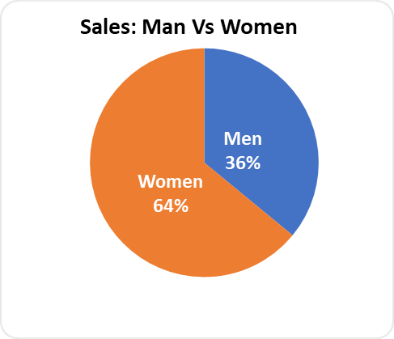
Revenue by Gender:
Women customers contribute significantly more to sales:
Women: ₹13,562,773
Men: ₹7,613,604
Insight:
Focus more on women's fashion lines, upselling, and promotions targeted at female demographics

Slide 3
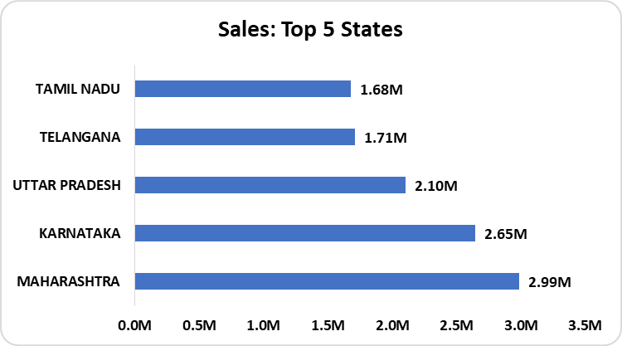
Top Performing States :
Top 3 States by Revenue:
Maharashtra – ₹2,990,221
Karnataka – ₹2,646,358
Uttar Pradesh – ₹2,104,659
Insight:
These states should receive higher ad spend and inventory priority.
Consider opening physical experience stores or pop-ups in these regions.

Slide 4
Platform Performance:
Top channel Amazon has the highest number of orders (1892) and revenue (₹1,622,033).
Insight:
Strengthen partnerships and optimize listings on high-performing platforms like Ajio and Myntra.

Slide 5
Identified Trends
Category | Observed Trend
Gender Sales | Women buyers drive most of the revenue
Geography | Revenue is highly concentrated in a few major states
Time-based | Consistent growth in sales across the first 3 months
Platform Usage | Ajio and Myntra outperform other channels
Product Category | Kurta and Sets dominate in purchase categories

Slide 6
Informed Decisions to Make
Targeted Marketing:
Focus marketing campaigns on women in Maharashtra, Karnataka, and UP.
Inventory Optimization:
Stock more sizes and styles of kurta and sets, especially in XXL, L, and M sizes.
Customer Segmentation:
Create offers for Senior and Teenager age groups (as seen in initial rows).
Channel Strategy:
Prioritize product launches and offers on Ajio and Myntra.

Slide 7
Recommendations to Grow the Store
Launch Location-Based Discounts for high-performing regions.
Introduce a Loyalty Program specifically for repeat women buyers.
Invest in SEO & Sponsored Ads on Ajio and Myntra platforms.
Run Thematic Campaigns around popular categories like kurta sets.
Consider Influencer Partnerships targeting female demographics aged 20-45.
Expand SKU variety for trending items to reduce missed revenue due to stockouts.

Slide 8
Thank You !

